Slide 1

VUE PROJECT
REST COUNTRIES API – n00191746

Slide 2
Vue Requirements
Libraries
Design
Implementation

Slide 3
Libraries used
Vue - The java framework used in this class
Bootstrap - is a library used to design the website
Axios - is used to interact with the API and use it in the application
Router - is the add on used to move from one page to the other
Three.Js – creating my 3D Solar System

Slide 4
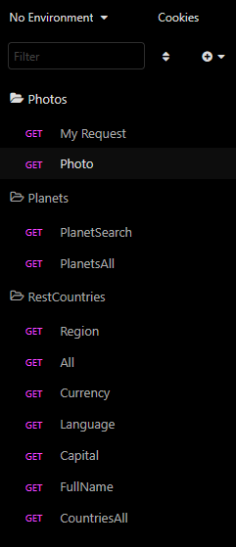
Insomnia Folder Structure
Insomnia was used to test our requests when using new Apis.
I organized each file in insomnia so that I knew what was needed for each section.
I ended up using various different Api’s in hopes to making my project more exciting.
I struggled with the images but eventually managed to figure out how to display them.

Slide 5
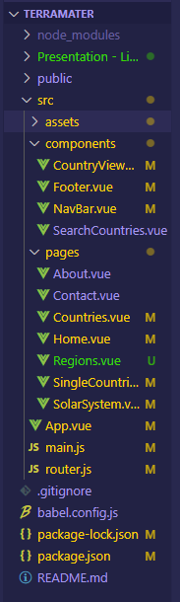
VUE project Folder Structure
All the libraries are stored in separate folders to keep them neat and organized.
The src folder contains most of the code that I used through out my CA.
The Components folder is used to store my Navbar, Footer as well as my Call functions.
Pages was used in conjunction with Router to call upon all the pages used in my website.

Slide 6
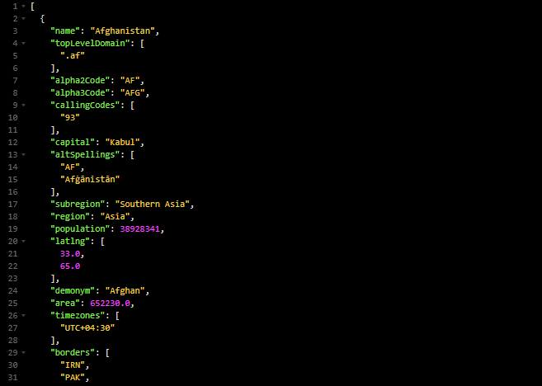
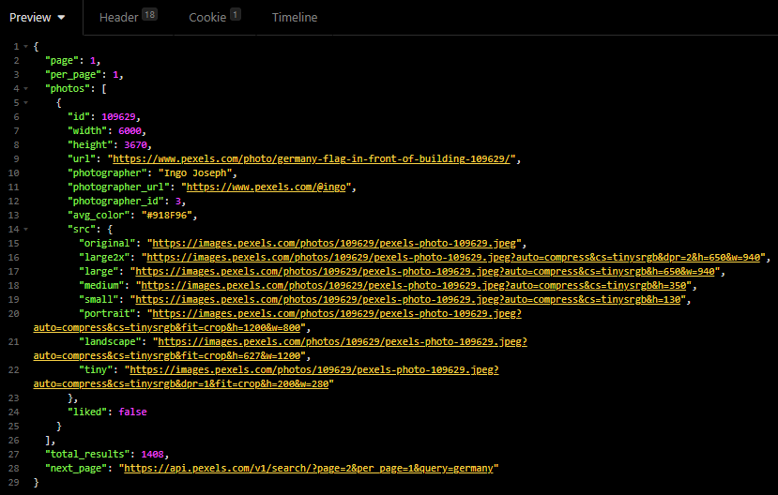
Example of commands used
https://restcountries.com/v3.1/all
https://api.pexels.com/v1/search?query=germany&per_page=1

Slide 7

Figma / photoshop Design
Space theme

Slide 8
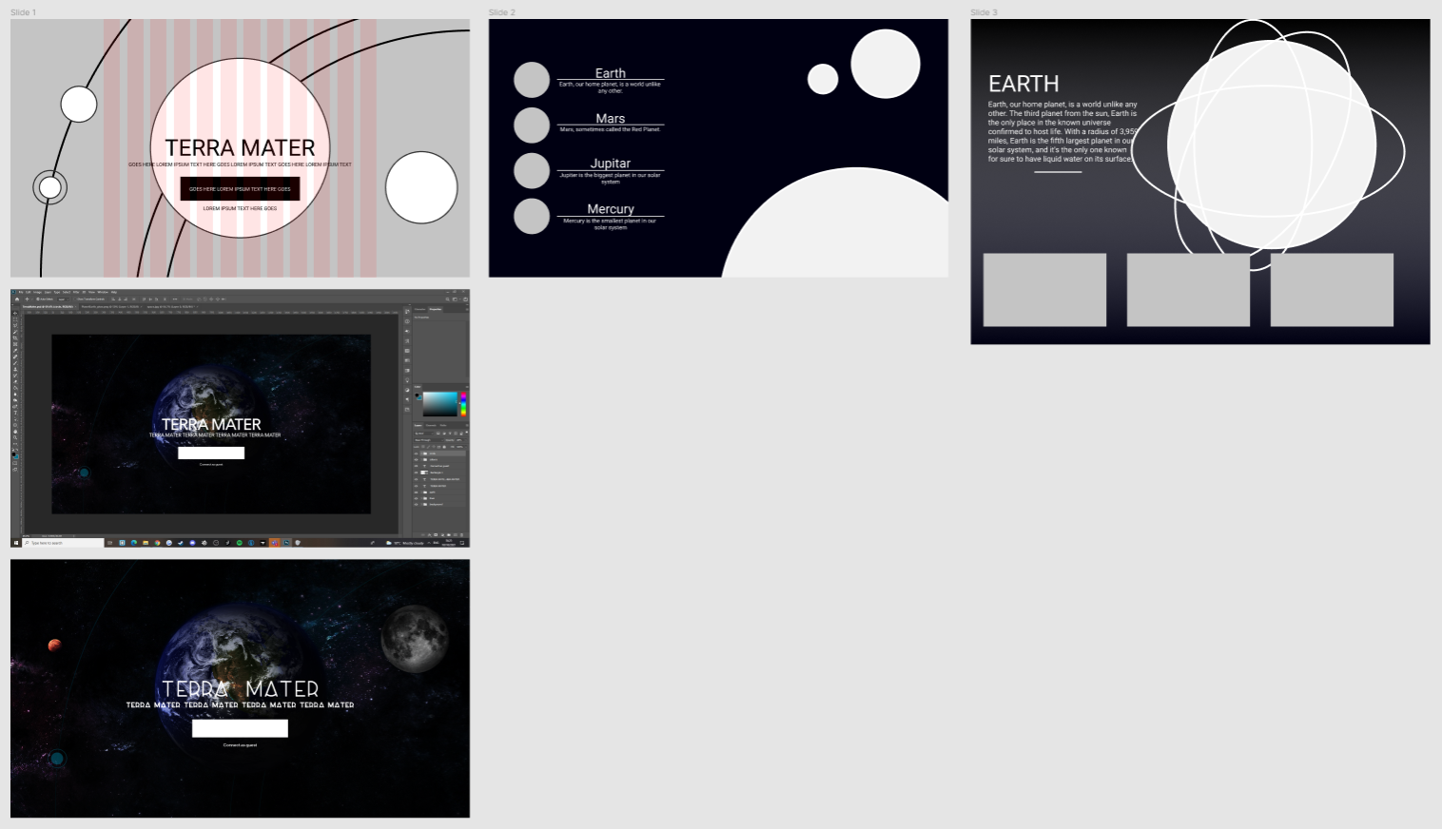

Slide 9
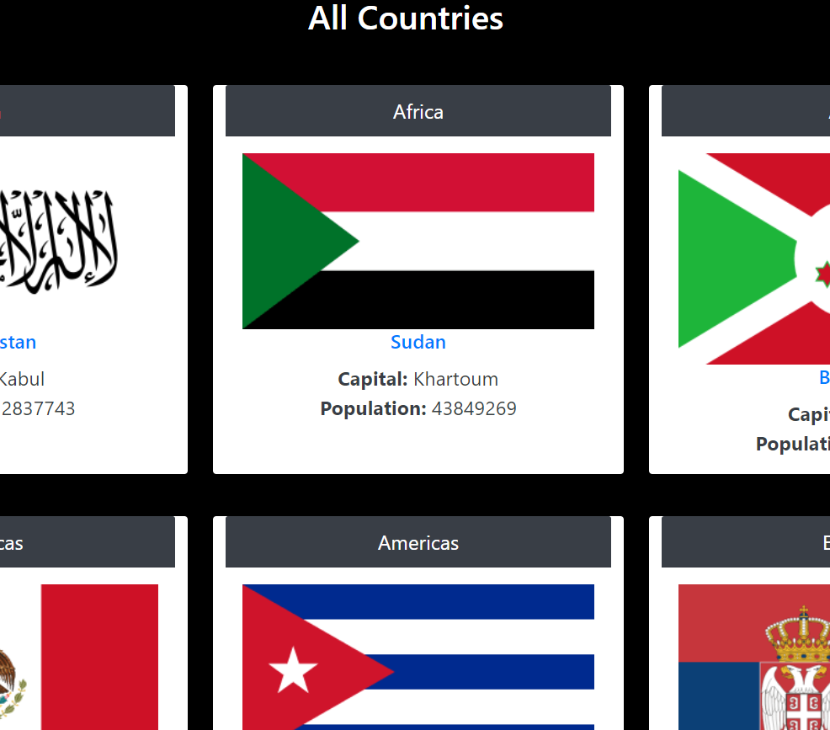

Examples of areas in which I used Vue components

Slide 10
Libraries Used
Vue Js - The java framework in which our CA was based off of.
Bootstrap – used to Design my website (Bootstrap-Vue).
Axios - is used to interact with the API and use it in the application.
Router - is what I used to move from one page to the other.
Three Js – Used to Create my Solar System.
Flickr-Sdk – Used to incorporate images into my project.

Slide 11

REferences
https://discourse.threejs.org/ - I was on here a lot asking questions and learning from various people.
https://stackoverflow.com/ - Stack Overflow was used similarly if I got stuck on anything, I could look at others work and see if it matched mine.
https://www.flickr.com/services/api/ - Flickr was used to incorporate my images, as a result I was reading its documents quiet often.
https://vuejs.org/ - As the core of my project, most of my time was spent here trying to learn new things.

Slide 12

Skills Taken away
Vue Js / Axios / Node Js
3D objects (Three Js)
Time Management

Slide 13

Thank You
Conor Weldon : N00191746

